Slide 1
Lecture 13
Introduction
Tibble
Data Types
Data Import with readr
Writing to a file

Slide 2
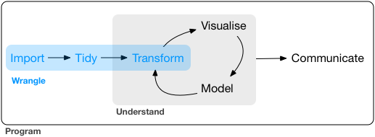
Wrangle: Introduction
Data Wrangling
  Data Wrangling is the art of getting data into R for visualization and modeling
  Three parts to Data Wrangling:
    Import
    Tidy
    Transform

Slide 3
Tibble
Tibbles are R packages used to manipulate and print data frames.
Tibbles are lazy and unfriendly data frames:
  they do less (i.e., they don’t change variable names or types, and don’t do partial matching) and
  they complain more (e.g., when a variable does not exist).
  this forces you to confront problems earlier, leading to cleaner, more expressive code.
Tibbles are a modern take on data frames
  They keep the features of data frames that have stood the test of time, and drop the features that used to be convenient but are now frustrating (i.e. converting character vectors to factors).
  They never change the input type (cannot convert string to factor)
  They never change variable names or create row names
  Tibble column names can be non-syntactic (non-valid R names)
  They have enhanced print( ) function, making them easier to use with large, complex data.
Installations of Tibble:
  install.packages("tidyverse") #easiest way to install Tibble
  install.packages("tibble") #alternative direct installation
  devtools::install_github("tidyverse/tibble") #development version from GitHub
Usage:
library(tidyverse)

Slide 4
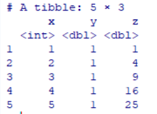

Creating R Tibble
Creating an R tibble
tibble(
x = 1:5,
y = 1,
z = x ^ 2
)
Non-Syntactic Names
  Tibbles have no row names
  Tibble column names need not be valid R names
  Tibble column names may not start with a letter and may contain any usual character, including space
  tb <- tibble(
  `:)` = "smile",
  ` ` = "space",
  `2000` = "number“
  )

Slide 5

Creating R Tibble
tribble()
  short for transposed tibble
  tribble() is customized for data entry in code
  column headings are defined by formulas (i.e., they start with ~)
  entries are separated by commas
  tribble(
  ~x, ~y, ~z,
  #--|--|----
  "a", 2, 3.6,
  "b", 1, 8.5
  )

Slide 6
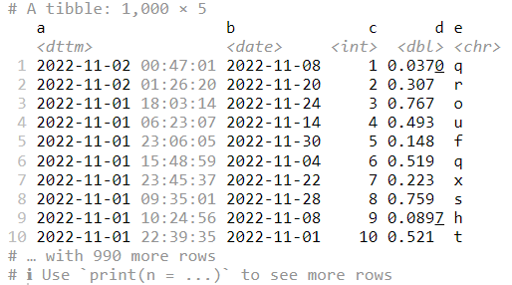
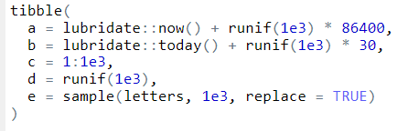
Tibbles vs Data Frame
Printing
  by default, tibbles print only the first 10 rows, and all the columns that fit on screen
  each column reports its type
  Explicit print( )
  nycflights13::flights %>%
  print(n = 10, width = Inf)
  Control print options
  options(tibble.print_max = n, tibble.print_min = m): if more than n rows, print only m rows. Use options(tibble.print_min = Inf) to always show all rows.
  View
  nycflights13::flights %>%
  View()

Slide 7
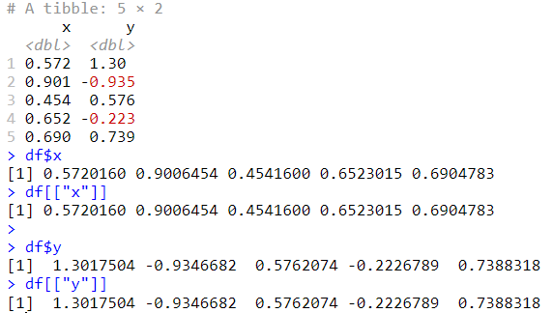
Tibbles vs Data Frame
Subsetting
  Tools to extract a single variable or subset of the dataset
  [[ can extract by name or position
  $ only extracts by name but is a little less typing.
  df <- tibble(
  x = runif(5),
  y = rnorm(5)
  )
  df$x
  df[[“x”]]
  df$y
  df[[“y”]]

Slide 8
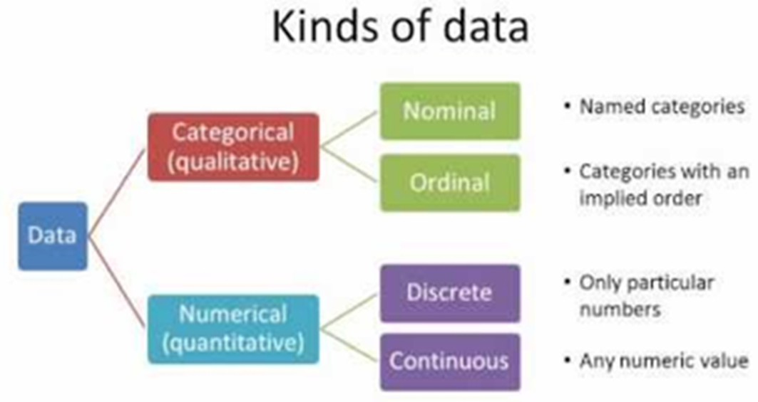
Data Types
  Nominal data, which is categorical data of no particular order
  Ordinal data, which is categorical data with a defined order
  Quantitative data, which is data that usually is represented by numeric values.

Slide 9
Data Types: Distinctions in R
  character / <chr>: Textual data, for example the text of a tweet.
  factor / <fct>: Categorical data with a finite number of categories with no particular order.
  ordered / <ord>: Categorical data with a finite number of categories with a particular order.
  double / <dbl>: Numerical data with decimal places.
  integer / <int>: Numerical data with whole numbers only (i.e. no decimals).
  logical / <lgl>: Logical data, which only consists of values TRUE and FALSE.
  date / date: Data which consists of dates, e.g. 2021-08-05.
  date-time / dttm: Data which consists of dates and times, e.g. 2021-08-05 16:29:25 BST.

Slide 10
Data Import with readr
  readr package provides a fast and friendly way to read rectangular data such as csv (comma separated values), tsv (tab-separated values), and
  fwf (fixed-width files)
  read_csv() reads comma delimited files
  read_csv2() reads semicolon separated files (common in countries where , is used as the decimal place)
  read_tsv() reads tab delimited files
  read_delim() reads in files with any delimiter.
  read_fwf() reads fixed width files. You can specify fields either by their widths with fwf_widths() or their position with fwf_positions().
  read_table() reads a common variation of fixed width files where columns are separated by white space.
  read_log() reads Apache style log files. (But also check out webreadr which is built on top of read_log() and provides many more helpful tools.)

Slide 11
Data Import with readr
  readr package provides a fast and friendly way to read rectangular data such as csv (comma separated values), tsv (tab-separated values), and
  fwf (fixed-width files)
  read_csv() reads comma delimited files
  read_csv2() reads semicolon separated files (common in countries where , is used as the decimal place)
  read_tsv() reads tab delimited files
  read_delim() reads in files with any delimiter.
  read_fwf() reads fixed width files. You can specify fields either by their widths with fwf_widths() or their position with fwf_positions().
  read_table() reads a common variation of fixed width files where columns are separated by white space.
  read_log() reads Apache style log files. (But also check out webreadr which is built on top of read_log() and provides many more helpful tools.)

Slide 12
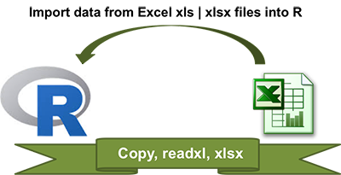
Reading Data From Excel Files (xls or xlsx) into R
Copying data from Excel and import into R
  On Windows system:
Open the Excel file containing your data: select and copy the data (ctrl + c)
Type the R code below to import the copied data from the clipboard into R and store the data in a data frame (my_data):
my_data <- read.table(file = "clipboard", sep = "\t", header=TRUE)
  On Mac OSX system:
Open the Excel file containing your data: select and copy the data (ctrl + c)
Type the R code below to import the copied data from the clipboard into R and store the data in a data frame (my_data):
  my_data <- read.table(pipe("pbpaste“), ="\t", header = TRUE)
  sep

Slide 13
Importing Excel files into R using readxl package
Use readxl package to import Excel files
  Read both xls and xlsx files:
# Loading
Library("readxl“)
# xls files
my_data <- read_excel("my_file.xls")
# xlsx files
my_data <- read_excel("my_file.xlsx")
  Specify sheet with a number or name
  # Specify sheet by its name
  my_data <- read_excel("my_file.xlsx", sheet = "data")
  # Specify sheet by its index
  my_data <- read_excel("my_file.xlsx", sheet = 2)
  Case of missing values: NA (not available)
  my_data <- read_excel("my_file.xlsx", na = "---")

Slide 14
Writing to a file
Writing data to csv files
  write.csv(my_data, file = "my_data.csv")
  write.csv2(my_data, file = "my_data.csv")
Writing data to text files
  write.table(my_data, file = "my_data.txt", sep = “ ")
Writing data to Excel files
  install.packages("xlsx")
  library("xlsx“)
  write.xlsx(my_data, file = "result.xlsx",
  sheetName = "my_data", append = FALSE)

